Slide 1
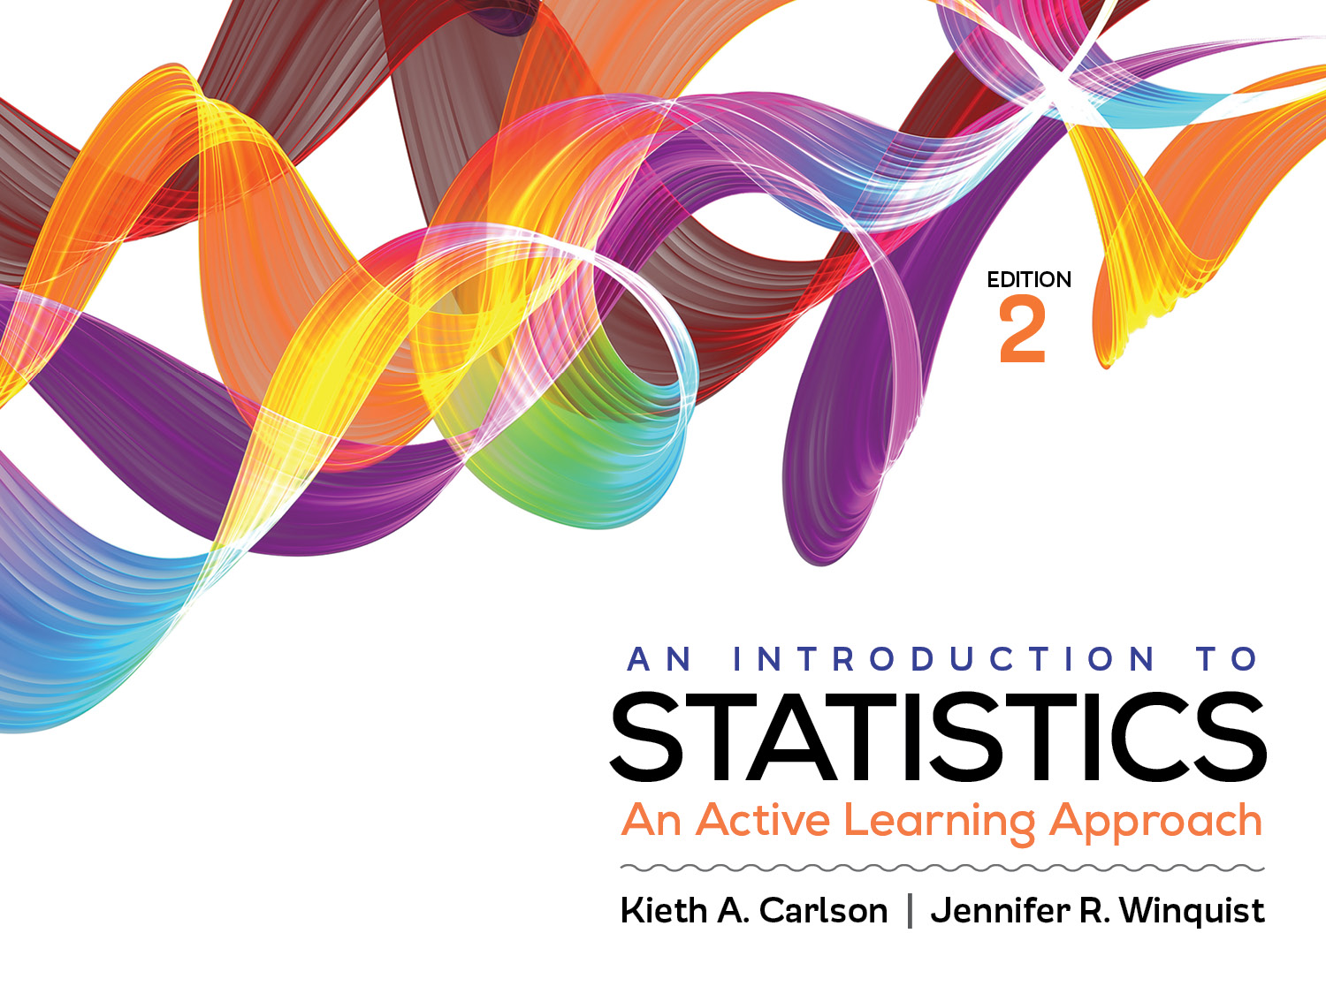
Introduction to Activity 14.1
Goodness-of-Fit Chi Square and Chi Square for Independence

Slide 2
Activity 14.1 will require you to:
Determine when to use each type of chi square
Work through all six steps of a hypothesis test using chi square of independence
Work through all 6 steps of a hypothesis test using a goodness-of-fit chi square

Slide 3
Chi-square
It analyzes frequencies
The data is category membership (nominal variables not interval/ratio variables)
It looks like ANOVA but it is not because . . .
There are two kinds of Chi-Square
Goodness of fit → for 1 nominal variable
Independence → for 2 nominal variables
Both compare expected frequency if null is true to observed frequency

Slide 4
Goodness of fit chi-square
A teacher asked 60 students to respond to the statement, “I like statistics” and each one responded with Yes or No. The teacher wanted to know if the frequency counts for “Yes” and “No” differed from half liking stats and half not liking stats. The collected data are below.
Like Stats | Don’t Like stats
35 | 25

Slide 5
State hypotheses
Null: the number of people liking and not liking statistics is not significantly different from 50% liking it and 50% not liking it.
Research: the number of people liking and not liking statistics is significantly different from 50% liking it and 50% not liking it.

Slide 6
Define critical region
df = number of categories – 1
df = 2 – 1 = 1
Critical value from Appendix = 3.84

Slide 7
Compute statistic
Determine expected frequency for each cell
N = 60; null expected .5 of N in each cell so . . .
EF for “like stats” = 60 * .5 = 30
EF for “don’t like stats” = 60 * .5 = 30
Compute obtained χ²
χ² = ∑(OF – EF)² / EF = ((35 – 30)² / 30) + ((25 – 30)² / 30) = .83 + .83 = 1.67
Like Stats | Don’t like stats
OF = 35 EF = 30 | OF = 25 EF = 30

Slide 8
Summarize results
The number of students who liked stats and did not like stats did not differ significantly from half liking it and half not liking it, χ² (1; N = 60) = 1.67, p > .05.

Slide 9
Independence chi-square
The teacher wants to know if there is an association between students liking stats and whether or not they are a psychology major. The teacher asked 60 student if they were a psychology major or not and if they liked statistics or not. The data is below:
 | Like stats | Does not like stats | Total
Psych major | 15 | 5 | 20
Not psych major | 10 | 30 | 40
Total | 25 | 35 | 60

Slide 10
State hypotheses
Null: there is not an association between whether or not one likes stats and whether or not one is a psychology major.
Research: there is an association between whether or not one likes stats and whether or not one is a psychology major.

Slide 11
Define critical region
df = (number of categories – 1) * (number of categories – 1)
df = 1 * 1 = 1
Critical value from Appendix = 3.84

Slide 12
Compute test statistic
Determine the expected frequencies (EF) if the null hypothesis is exactly true. Each cell has its own expected frequency.
EF =(RT * CT)/ N = (20 * 25) / 60 = 8.33
 | Like stats | Does not like stats | Total
Psych major | 15 8.33 | 5 11.67 | 20
Not psych major | 10 16.67 | 30 23.33 | 40
Total | 25 | 35 | 60

Slide 13
Compute test statistic
Compute the obtained chi square
χ² = ∑(OF – EF)² / EF =
χ² = ((15 – 8.33)² / 8.33) + ((5 – 11.67)² / 11.67) +
((10 – 16.67)² / 16.67) + ((30 – 23.33)² / 23.33)
χ² = 5.34 + 3.81 + 2.67 + 1.91 = 13.73

Slide 14
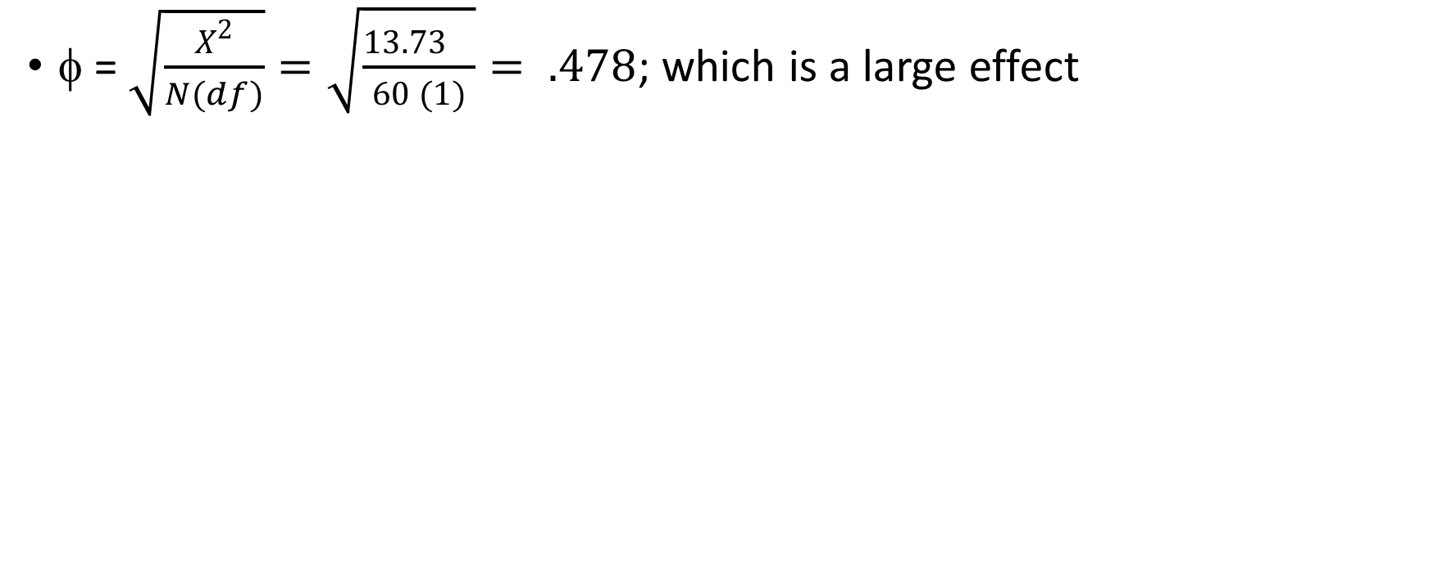
Compute effect size
φ = $\sqrt{\frac{X^{2}}{N(df)}}=\sqrt{\frac{{13.73}^{}}{60 (1)}}= .478$; which is a large effect

Slide 15
Summarize the results
There is a significant association between being a psychology major and liking statistics, χ² (1; N = 60) = 13.73, p < .05, φ = .48. More psychology majors liked stats than was expected by chance and fewer non-psychology majors liked stats than was expected by chance.

